Slide 1
Sales Analysis Using Tableau
- Dhruv Lodaria

Slide 2
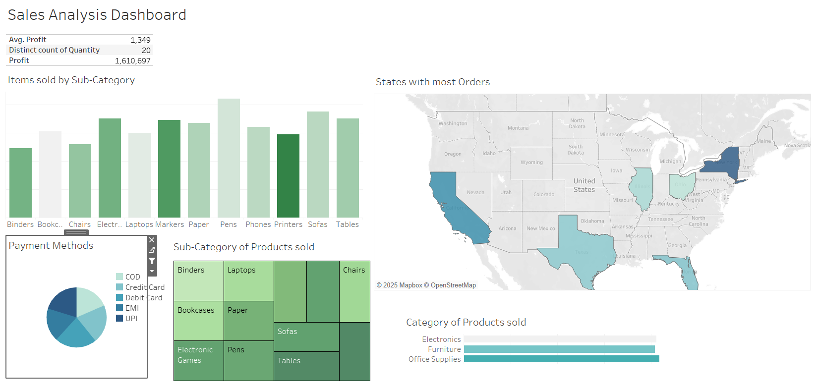
Dashboard

Slide 3
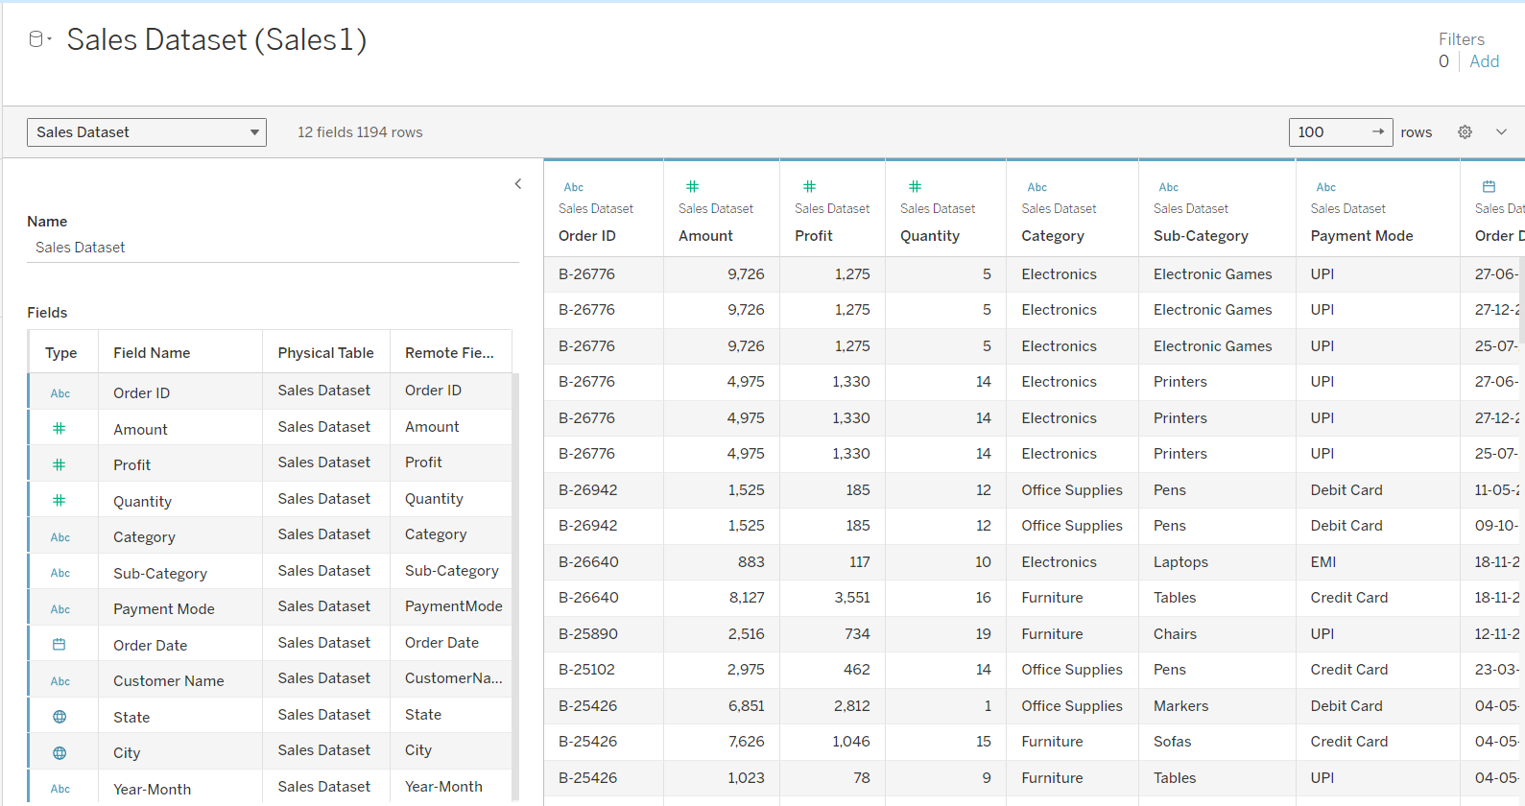
Dataset
This dataset captures detailed sales transactions, including metrics like profit, quantity, and amount, along with categorical fields such as product category, payment mode, and customer geography. It enables comprehensive analysis of sales performance across different dimensions like time, location, and product types.

Slide 4
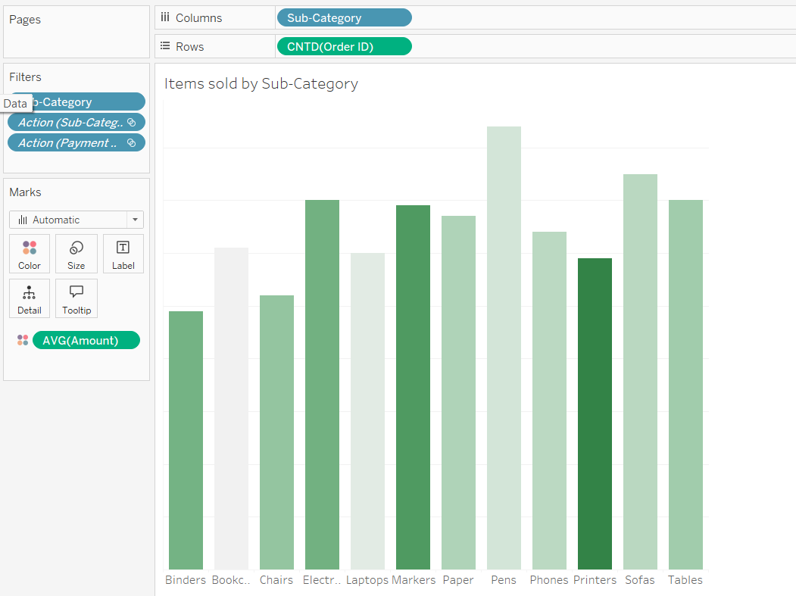
Charts
This chart shows the chart between Sub-category and Number of Orders. I have used the Average Amount of Order Value as its colour attribute.

Slide 5
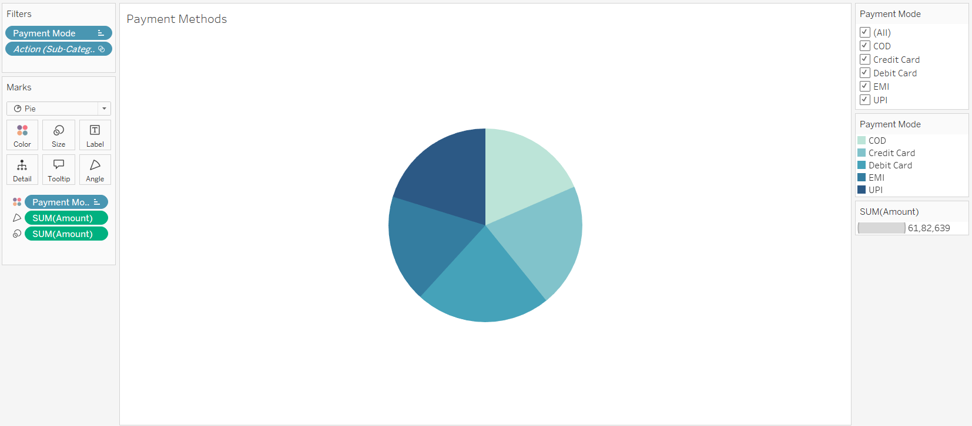
This pie diagram shows the Types of Payment Methods used by the customers.

Slide 6
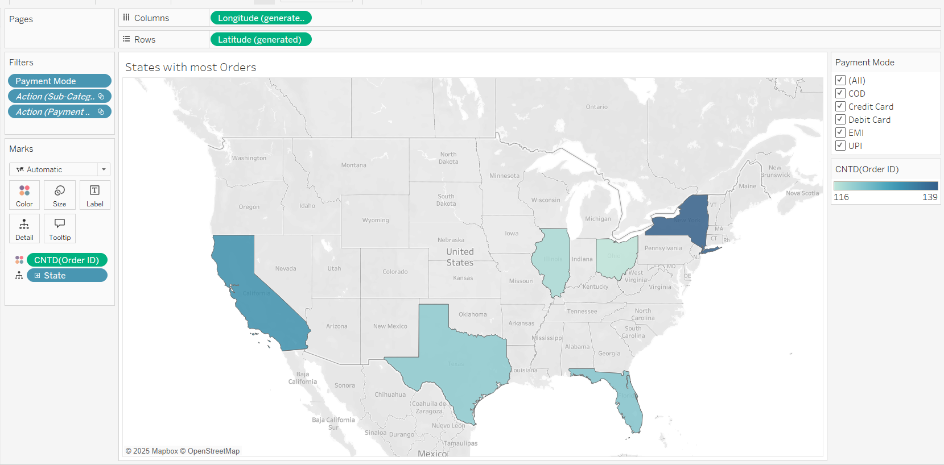
This Map Diagram shows the top States with the highest number of Orders.

Slide 7
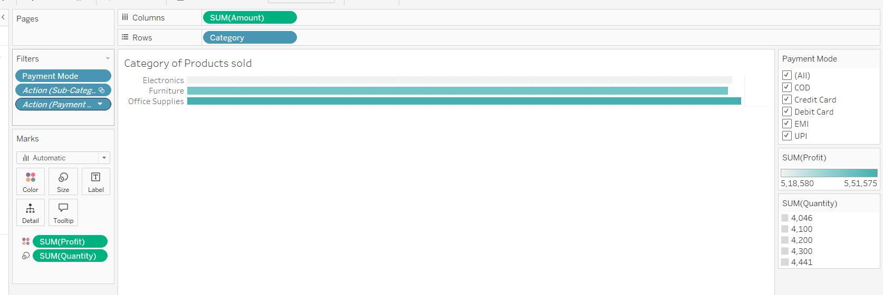
This chart shows Different Categories of Products sold.

Slide 8
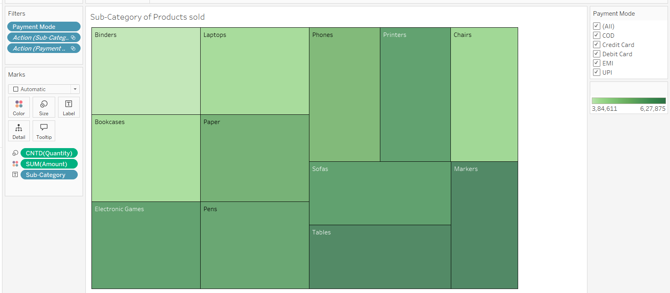
This Heatmap shows the Sub-Category of the Products sold.

Slide 9
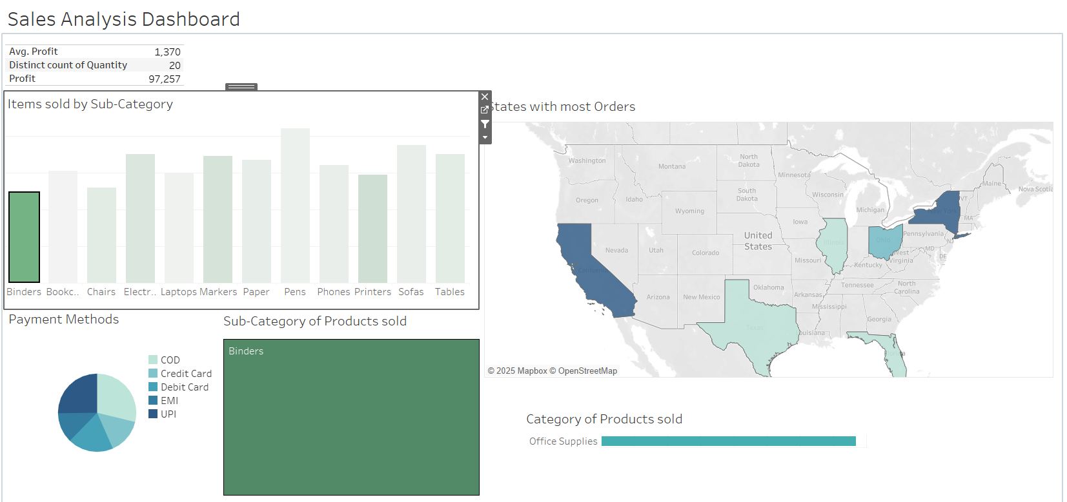
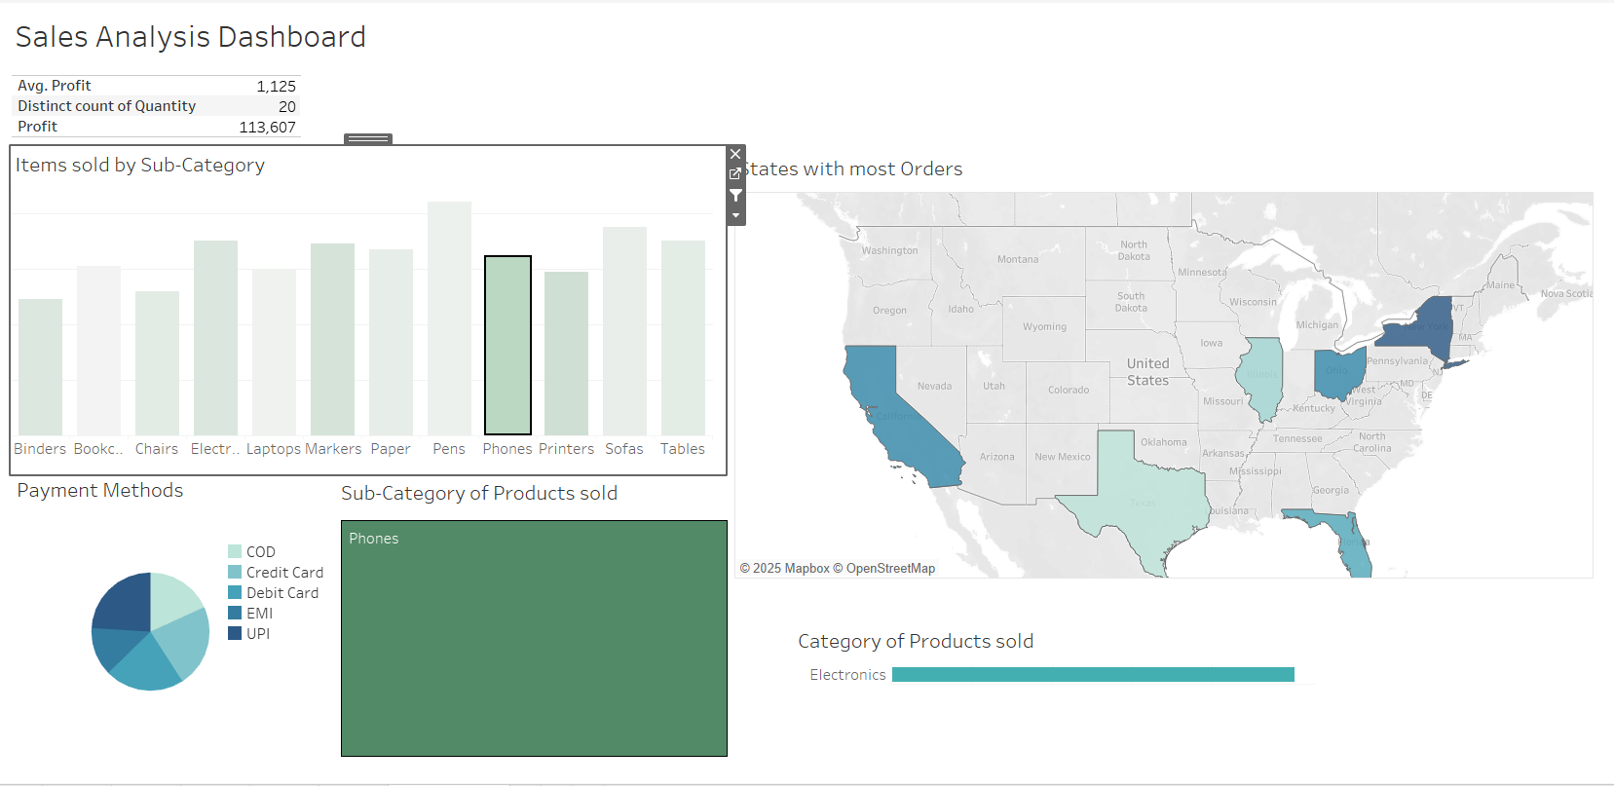
This is an interactive Dashboard. As shown here, in the first image the When Binders is selected, all the values in the Dashboard shows the values for the Binders.

Slide 10
THANK YOU!!

